Slide 1

Effects of Sugar Consumption
CAITLYN Beachey, Amaris assan, Cecilia leung, Hillary mandich, kapil pundhir

Slide 2
PRESENTATION GUIDELINES
Trivial Question
Core Message
Define the Project
Data Exploration
Data Cleanup
Data Analysis
Discussion
Post Mortem
Questions

Slide 3
TRIVIAL QUESTION
Do any of you know what your daily sugar intake should be?

Slide 4
CORE MESSAGE
“Your sandwich bread is actually a cake!”
As we investigated this article, we wondered what the average daily sugar intake is and got curious if we are eating too much sugar that may be detrimental to our health.
Based on the facts:
Men should consume xx amount per day
Women should consume xx amount per day

Slide 5
DEFINE THE PROJECT
What is the average daily intake of processed sugar globally? Which countries consume the most on average?
How has the average sugar intake changed over time?
What is the correlation between income and sugar intake?
Is there a correlation between processed sugar and obesity?
Is there a correlation between processed sugar and dental health?
What are the top 5 purchased grocery items in the country with the highest sugar intake? For these 5 top items, what is their sugar content?
Notes:
We saw various articles about negative effects of sugar consumption, we just wanted to see how it affects our health and economy if this trend continues.

Slide 6
DATA EXPLORATION
FAO
Kaggle
Kroger Purchase Data
Datasets
Fat Secret API
WHO
Worldbank

Slide 7
DATA CLEANUP – INSIGHTS AND DIFFICULTIES
Requires team effort to brainstorm on where to get the data.
May require paying money to access the optimal data source for analysis.
Time consuming to research the right data for our analysis.
Datasets are not formatted perfectly to answer our questions.
Requires reformatting CSV files in proper rows and columns.
Merging dataframes to determine trends and correlation.
Not all information for a specific country may not be available as some of the countries were not independent until 1990-1993.

Slide 8
DATA CLEANUP – INTERESTING FIGURES
Upon retrieving the datasets, we were able to find the following trends:
Countries that Consume the most sugars.
Trends of Sugar Consumption over the years.
Correlation of Sugar Consumption between Income, Bad Teeth and Obesity.
Grocery Data of Most Purchased Product.

Slide 9
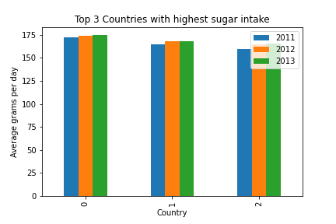
DATA ANALYSIS - 1
What is the average daily sugar intake and which countries have the highest sugar consumption?

Slide 10
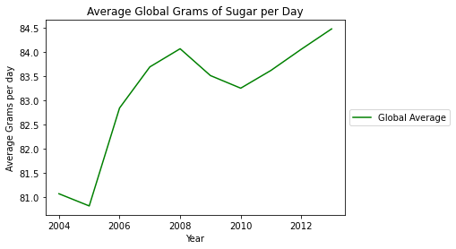
DATA ANALYSIS - 2
How has the average sugar intake changed over time?

Slide 11
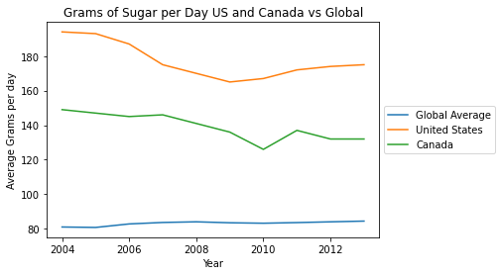
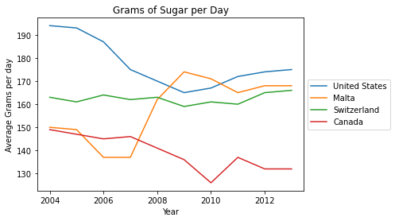
DATA ANALYSIS – 2
How does Canada fare against the other countries?

Slide 12
DATA ANALYSIS - 3
What is the correlation between income and sugar intake?
Comparison of the Income Dataset from Worldbank and Sugar Intake Data from FAO show that countries with lower income has higher sugar intake.

Slide 13
DATA ANALYSIS - 4
Is there a correlation between processed sugar and obesity?
Comparison of Obesity data from WHO and Sugar Intake Data from FAO show that countries with lower income has higher sugar intake.

Slide 14
DATA ANALYSIS - 5
Is there a correlation between processed sugar and dental health?
Comparison of Bad Teeth Data from WHO and Sugar Intake Data from FAO, there is almost no correlation between sugar intake and dental health.

Slide 15
DATA ANALYSIS - 5
Is there a correlation between processed sugar and dental health?
Comparison of Bad Teeth Data from WHO and Sugar Intake Data from FAO, there is almost no correlation between sugar intake and dental health.

Slide 16
DATA ANALYSIS - 6
What are the top 5 purchased grocery items in the country with the highest sugar intake? For these 5 top items, what is their sugar content?
The American Kroger grocery store datasets had a list of groceries item purchased by 38,000+ customers. Then we had a nutrition API from Fat Secret to determine the sugar content.

Slide 17
DISCUSSION ON FINDINGS
What are the top 5 purchased grocery items in the country with the highest sugar intake? For these 5 top items, what is their sugar content?
The American Kroger grocery store datasets had a list of groceries item purchased by 38,000+ customers. Then we had a nutrition API from Fat Secret to determine the sugar content.

Slide 18
POST MORTEM
What are the top 5 purchased grocery items in the country with the highest sugar intake? For these 5 top items, what is their sugar content?
The American Kroger grocery store datasets had a list of groceries item purchased by 38,000+ customers. Then we had a nutrition API from Fat Secret to determine the sugar content.

Slide 19
QUESTIONS
Any questions from all of you regarding our project?

